Slide 1
Graph Theory Lab Results
Florian Speer & Nils Schröder
17.01.2025

Slide 2
Methodology
Invariant Analysis
Identify the most promising invariants (execution time vs number of clusters)
Isomorphism Analysis
Find the overall fastest invariant including the isomorphism checks
Isomorphism Scaling Analysis
Investigate the asymptotic scaling

Slide 3
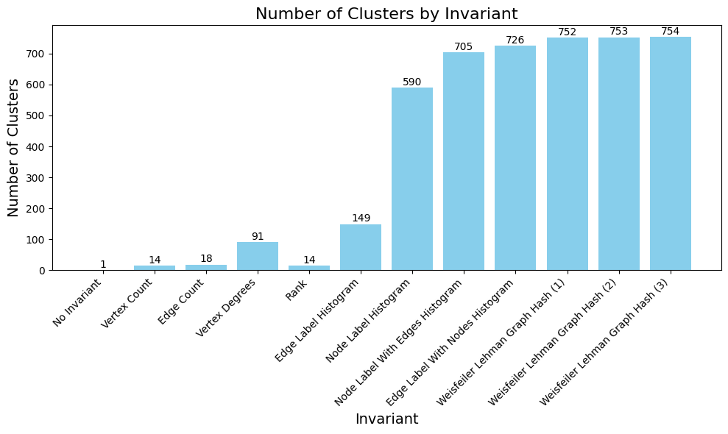
Invariant analysis
Total number of cluster = 754
Notes:
Number of cluster (bar chart sample size 1)
Execution time
Num cluster / ms
Variance (definition + bar chart)

Slide 4
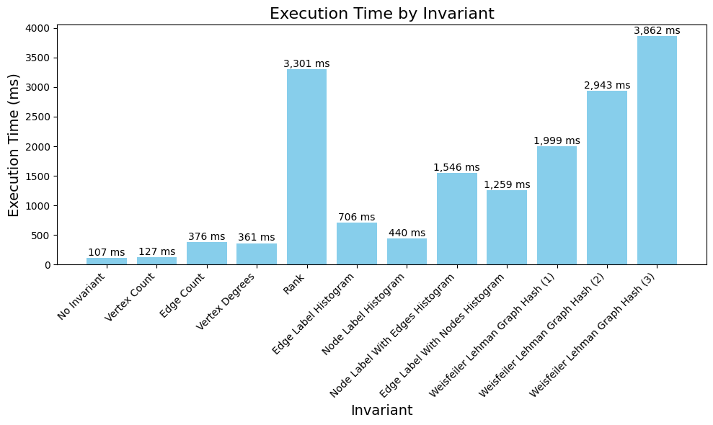
Invariant analysis
Notes:
Number of cluster (bar chart sample size 1)
Execution time
Num cluster / ms
Variance (definition + bar chart)

Slide 5
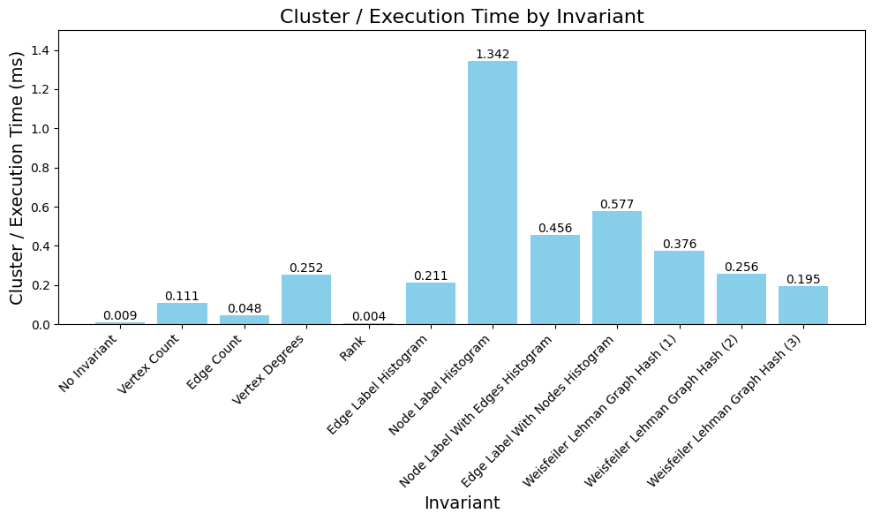
Invariant analysis
Notes:
Number of cluster (bar chart sample size 1)
Execution time
Num cluster / ms
Variance (definition + bar chart) <- 3 charts reichen glaube ich

Slide 6
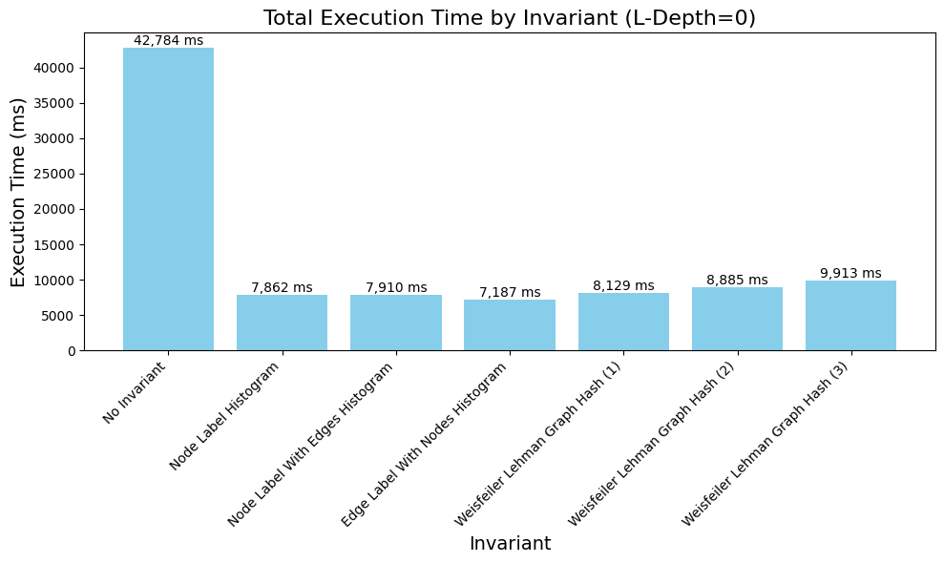
Isomorphism Analysis
Notes:
L-depth growth (execution time lineplot)
Execution time (bar chart l-depth 0)

Slide 7
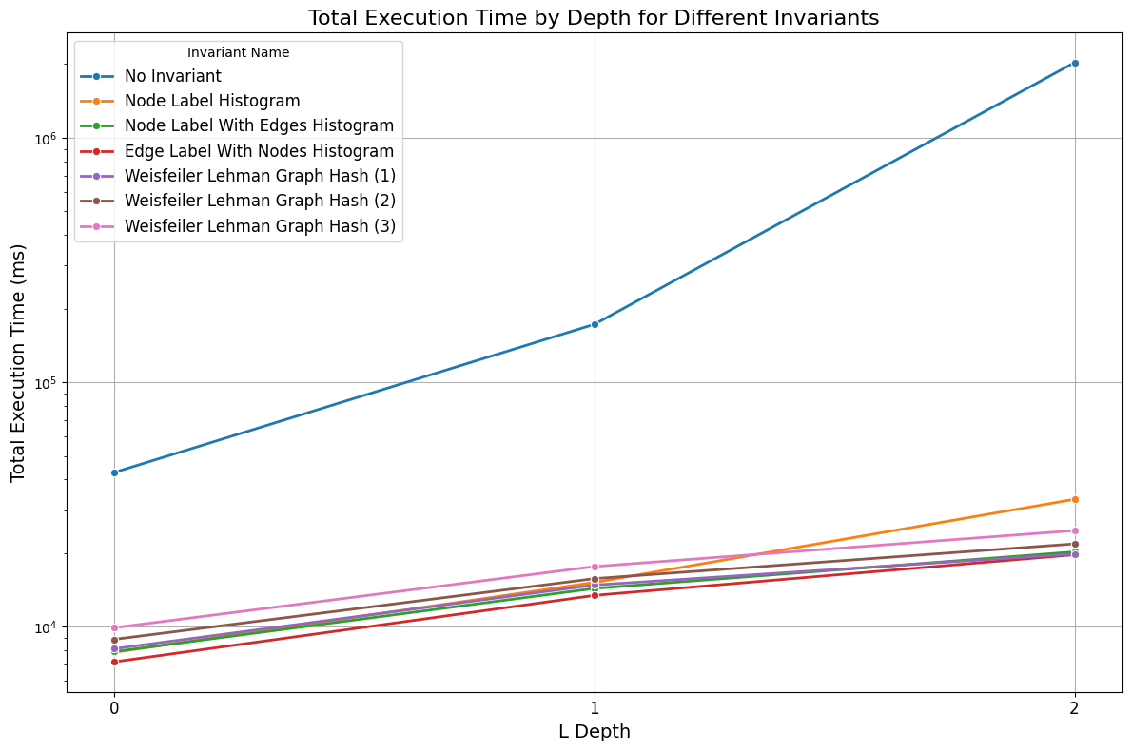
Isomorphism Analysis
speedup
> 16x
Notes:
L-depth growth (execution time lineplot)
Execution time (bar chart l-depth 0)

Slide 8
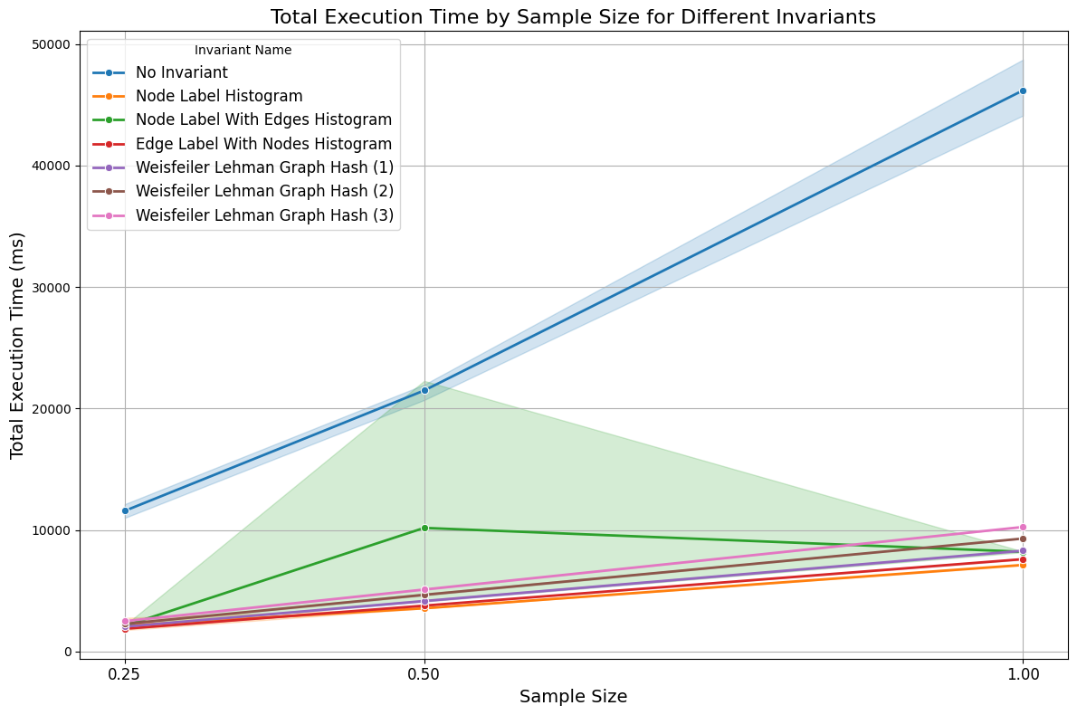
Isomorphism Scaling Analysis
L-Depth=0
Notes:
Sample size growth (execution time lineplot)
Number of checks (cluster growth)
Vs cluster growth with increasing l-depth

Slide 9
CONCLUSION
Number of clusters has a larger influence on execution time than number of total reactions
Label Histograms and Weisfeiler Lehmann Graph Hash are the best invariants
Linear scaling for increasing number of reactions
Exponential scaling for increasing L Depths
Edge Label with Nodes Histogram has the lowest total execution time
Node Label Histogram produces many clusters in short time
Weisfeiler Lehman Graph Hash finds with 3 Iterations all clusters for L-Depth 0-2
Notes:
Sample size growth (execution time lineplot)
Number of checks (cluster growth) <- same as time axis
Vs cluster growth with increasing l-depth

Slide 10
Vielen Dank!

